Slide 1

Chapter 9 Objects and Classes

Slide 2
Objectives
To understand objects and classes, and use classes to model objects (§9.2).
To use UML graphical notations to describe classes and objects (§9.2).
To understand the role of constructors when creating objects (§9.3).
To learn how to declare a class and how to create an object of a class (§9.4).
To know how to separate a class declaration from a class implementation (§9.5).
To access object members using pointers (§9.6).
To create objects using the new operator on the heap (§9.7).
To process strings using the C++ string class (§9.8).
To declare private data fields with appropriate get and set functions for data field encapsulation to make classes easy to maintain (§9.9).
To understand the scope of data fields (§9.10).
To reference hidden data field using the this pointer (§9.11).
To develop functions with object arguments (§9.12).
To store and process objects in arrays (§9.13).
To apply class abstraction to develop software (§§9.14-9.15).
To initialize data fields with a constructor initializer (§9.16).

Slide 3
OO Programming Concepts
In procedural programming, which only functions are used to be the basic modules, data and operations on the data are separate, this methodology requires sending data to procedures and functions. Object-oriented programming places data and the operations pertain to them within a single entity called object, this method solves many of the problems inherent in procedural programming.

Slide 4
OO Programming Concepts
Object-oriented programming (OOP) involves programming using objects. An object represents an entity in the real world that can be distinctly identified. For example, a student, a desk, a circle, a button, and even a loan can all be viewed as objects. An object has a unique identity, state, and behaviors. The state of an object consists of a set of data fields (also known as properties) with their current values. The behavior of an object is defined by a set of functions.

Slide 5
OO Programming Concepts
The objected-oriented programming approach organizes programs in a way that mirrors the real world, in which all objects are associated with both attributes and activities. Using objects improves software reusability and makes programs easier to develop and easier to maintain. Object-oriented programming involves thinking in terms of objects, a program can be viewed as a collection of cooperating objects.

Slide 6
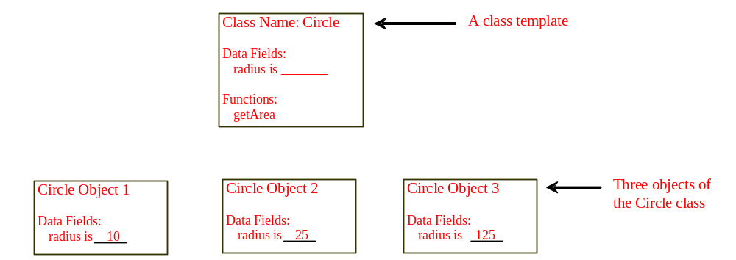
Objects
An object has both a state and behavior. The state defines the object, and the behavior defines what the object does. The state of an object is represented by data fields. The behavior of an object is defined as a set of functions. So, invoking a function on an object is to ask the object to perform a task.
Notes:
The relationship between datatype and value.

Slide 7
Classes
A class is a template or a blueprint that defines what an object’s data and functions will be. An object is an instance of a class. The relationship between class and object is the same with data type and value.
Classes are constructs that define objects of the same type. A class uses variables to define data fields and functions to define behaviors. Additionally, a class provides a special type of functions, known as constructors, which are invoked to construct objects from the class.

Slide 8
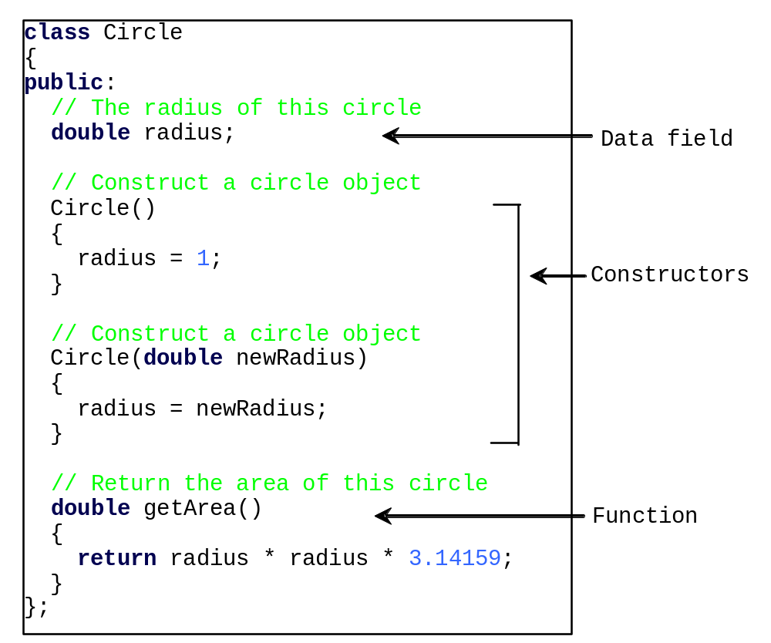
Classes

Slide 9
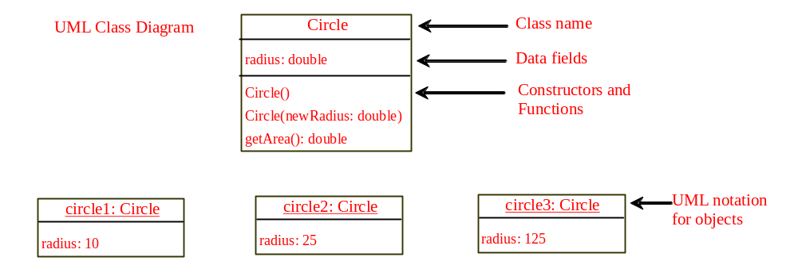
UML Class Diagram
Notes:
Show UML diagram using visio.

Slide 10
Constructors
The constructor has exactly the same name as the defining class. Like regular functions, constructors can be overloaded (i.e., multiple constructors with the same name but different signatures), making it easy to construct objects with different initial data values.
A class normally provides a constructor without arguments (e.g., Circle()). Such constructor is called a no-arg or no-argument constructor.
A class may be declared without constructors. In this case, a no-arg constructor with an empty body is implicitly declared in the class. This constructor, called a default constructor, is provided automatically only if no constructors are explicitly declared in the class.

Slide 11
Constructors, cont.
Constructors are a special kind of function, with three differences:
Constructors must have the same name as the class itself.
Constructors do not have a return type—not even void.
Constructors play the role of initializing objects. So, constructors are called implicitly.

Slide 12
Object Names
In C++, you can assign a name when creating an object. A constructor is invoked when an object is created. The syntax to create an object using the no-arg constructor is
ClassName objectName;
For example,
Circle circle1;

Slide 13
Constructing with Arguments
The syntax to declare an object using a constructor with arguments is
ClassName objectName(arguments);
For example, the following declaration creates an object named circle2 by invoking the Circle class’s constructor with a specified radius 5.5.
Circle circle2(5.5);

Slide 14
Access Operator (t.b.c 5.16)
After an object is created, its data can be accessed and its functions invoked using the dot operator (.), also known as the object member access operator:
objectName.dataField references a data field in the object.
objectName.function(arguments) invokes a function on the object.

Slide 15
A Simple Circle Class
Objective: Demonstrate creating objects, accessing data, and using functions.
TestCircle

Slide 16
Naming Objects and Classes
When you declare a custom class, capitalize the first letter of each word in a class name; for example, the class names Circle, Rectangle, and Desk. The class names in the C++ library are named in lowercase. The objects are named like variables.

Slide 17
Class is a Type
You can use primitive data types to define variables. You can also use class names to declare object names. In this sense, a class is also a data type.

Slide 18
Memberwise Copy
In C++, you can also use the assignment operator = to copy the contents from one object to the other. By default, each data field of one object is copied to its counterpart in the other object. For example,
circle2 = circle1;
copies the radius in circle1 to circle2. After the copy, circle1 and circle2 are still two different objects, but with the same radius.
When object copy is executed, copy constructor is in fact called.

Slide 19
Constant Object Name
Object names are like array names. Once an object name is declared, it references to an object. It cannot be reassigned to reference another object. In this sense, an object name is a constant, though the contents of the object may change.

Slide 20
Anonymous Object
Most of the time, you create a named object and later access the members of the object through its name. Occasionally, you may create an object and use it only once. In this case, you don’t have to name the object. Such objects are called anonymous objects.
The syntax to create an anonymous object using the no-arg constructor is
  ClassName()
The syntax to create an anonymous object using the constructor with arguments is
  ClassName(arguements)
Notes:
Another type of anonymous object is the object allocated in the heap memory by calling new operator.

Slide 21
Separating Declaration from Implementation
C++ allows you to separate class declaration from implementation. The class declaration describes the contract of the class and the class implementation implements the contract. The class declaration simply lists all the data fields, constructor prototypes, and the function prototypes. The class implementation implements the constructors and functions. The class declaration and implementation are in two separate files. Both files should have the same name, but with different extension names. The class declaration file has an extension name .h and the class implementation file has an extension name .cpp.
Circle.h
Circle.cpp

Slide 22
Inline Declaration
§5.16, “Inline Functions,” introduced how to improve function efficiency using inline functions. Inline functions play an important role in class declarations. When a function is implemented inside a class declaration, it automatically becomes an inline function. This is also known as inline declaration.
We call this inline declaration as implicit inline declaration.

Slide 23
Inline Declaration Example
class A
{
public:
A()
{
// do something;
}
double f1()
{
// return a number
}
double f2();
};
For example, in the following declaration for class A, the constructor and function f1 are automatically inline functions, but function f2 is a regular function.

Slide 24
Inline Functions in Implementation File
There is another way to declare inline functions for classes. You may declare inline functions in the class’s implementation file. For example, to declare function f2 as an inline function, precede the inline keyword in the function header as follows: (We can call this inline declaration as explicit inline declaration.)
// Implement function as inline
inline double A::f2()
{
// return a number
}

Slide 25
Inline Declarations?
As noted in §5.16, short functions are good candidates for inline functions, but long functions are not.

Slide 26
Accessing Object Members via Pointers
Object names cannot be changed once they are declared. However, you can create pointers for object names and assign new object names to pointers whenever necessary. For example,
  Circle circle1;
  Circle *pCircle = &circle1;
  cout << "The radius is " << (*pCircle).radius << endl;
  cout << "The area is " << (*pCircle).getArea() << endl;
  (*pCircle).radius = 5.5;
  cout << "The radius is " << (*pCircle).radius << endl;
  cout << "The area is " << (*pCircle).getArea() << endl;

Slide 27
Creating Dynamic Objects on Heap
When you declare a circle object in a function, it is created in the stack. When the function returns, the object is destroyed. To retain the object, you may create it dynamically on the heap using the new operator.
ClassName *pObject = new ClassName();

Slide 28
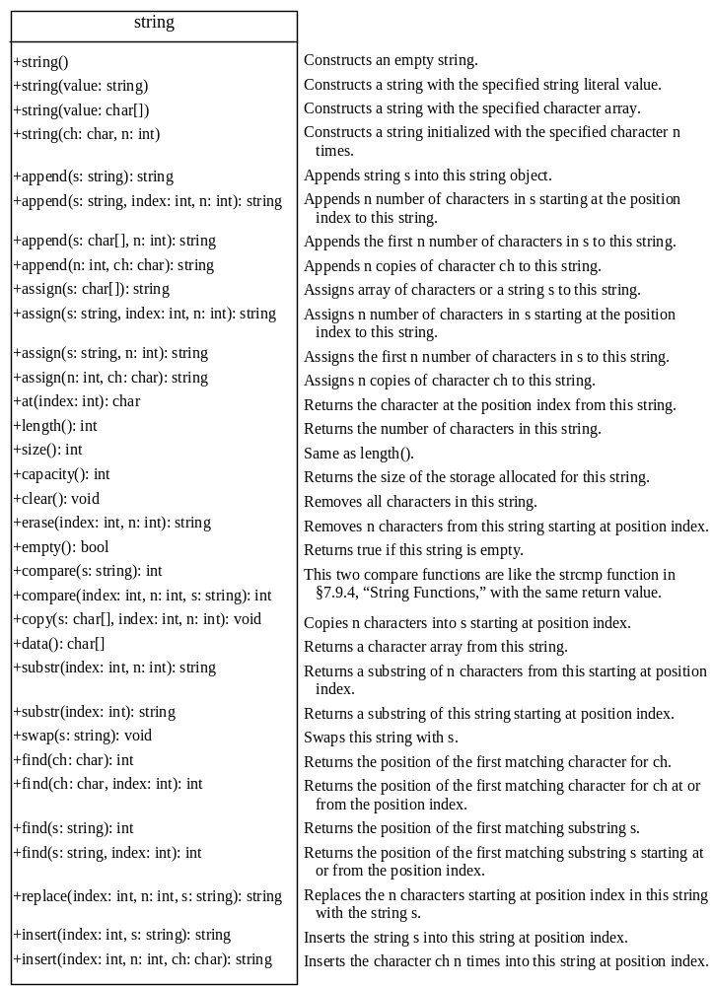
The C++ string Class
In C++ programming language, we can process strings using two ways. One is to use char array or char pointer. The other is to use string class.

Slide 29
Constructing a String
You can create an empty string using string’s no-arg constructor like this one:
string newString;
You can create a string object from a string value or from an array of characters. To create a string from a string literal, use a syntax like this one:
string newString(stringLiteral);

Slide 30
Appending a String
You can use several overloaded functions to add new contents to a string. For example, see the following code:
string s1("Welcome");
s1.append(" to C++"); // appends " to C++" to s1
cout << s1 << endl; // s1 now becomes Welcome to C++
string s2("Welcome");
s2.append(" to C and C++", 0, 5); // appends " to C" to s2
cout << s2 << endl; // s2 now becomes Welcome to C
string s3("Welcome");
s3.append(" to C and C++", 5); // appends " to C" to s3
cout << s3 << endl; // s3 now becomes Welcome to C
string s4("Welcome");
s4.append(4, 'G'); // appends "GGGG" to s4
cout << s4 << endl; // s4 now becomes WelcomeGGGG

Slide 31
Assigning a String
You can use several overloaded functions to assign new contents to a string. For example, see the following code:
string s1("Welcome");
s1.assign("Dallas"); // assigns "Dallas" to s1
cout << s1 << endl; // s1 now becomes Dallas
string s2("Welcome");
s2.assign("Dallas, Texas", 0, 5); // assigns "Dalla" to s2
cout << s2 << endl; // s2 now becomes Dalla
string s3("Welcome");
s3.assign("Dallas, Texas", 5); // assigns "Dalla" to s3
cout << s3 << endl; // s3 now becomes Dalla
string s4("Welcome");
s4.assign(4, 'G'); // assigns "GGGG" to s4
cout << s4 << endl; // s4 now becomes GGGG

Slide 32
Functions at, clear, erase, and empty
You can use the at(index) function to retrieve a character at a specified index, clear() to clear the string, erase(index, n) to delete part of the string, and empty() to test if a string is empty. For example, see the following code:
string s1("Welcome");
cout << s1.at(3) << endl; // s1.at(3) returns c
cout << s1.erase(2, 3) << endl; // s1 is now Weme
s1.clear(); // s1 is now empty
cout << s1.empty() << endl; // s1.empty returns 1 (means true)

Slide 33
Comparing Strings
Often, in a program, you need to compare the contents of two strings. You can use the compare function. This function works in the same way as the C-string strcmp function and returns a value greater than 0, 0, or less than 0. For example, see the following code:
string s1("Welcome");
string s2("Welcomg");
cout << s1.compare(s2) << endl; // returns -2
cout << s2.compare(s1) << endl; // returns 2
cout << s1.compare("Welcome") << endl; // returns 0

Slide 34
Obtaining Substrings
You can obtain a single character from a string using the at function. You can also obtain a substring from a string using the substr function. For example, see the following code:
string s1("Welcome");
cout << s1.substr(0, 1) << endl; // returns W
cout << s1.substr(3) << endl; // returns come
cout << s1.substr(3, 3) << endl; // returns com

Slide 35
Searching in a String
You can use the find function to search for a substring or a character in a string. For example, see the following code:
string s1("Welcome to HTML");
cout << s1.find("co") << endl; // returns 3
cout << s1.find("co", 6) << endl; // returns -1
cout << s1.find('o') << endl; // returns 4
cout << s1.find('o', 6) << endl; // returns 9

Slide 36
Inserting and Replacing Strings
Here are the examples to use the insert and replace functions:
string s1("Welcome to HTML");
s1.insert(11, "C++ and ");
cout << s1 << endl; // s1 becomes Welcome to C++ and HTML
string s2("AA");
s2.insert(1, 4, 'B');
cout << s2 << endl; // s2 becomes to ABBBBA
string s3("Welcome to HTML");
s3.replace(11, 4, "C++");
cout << s3 << endl; // returns Welcome to C++

Slide 37
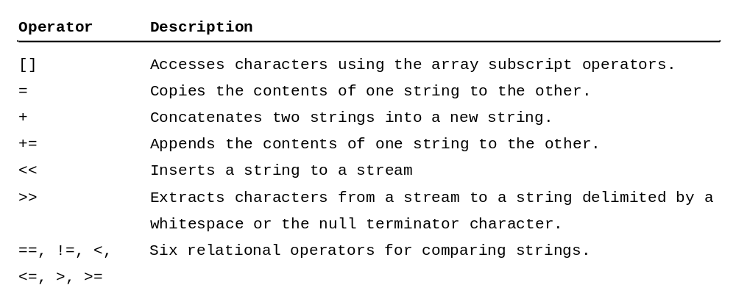
String Operators

Slide 38
Data Field Encapsulation(Here)
The data fields radius in the Circle class in Listing 9.1 can be modified directly (e.g., circle1.radius = 5). This is not a good practice for two reasons:
First, data may be tampered.
Second, it makes the class difficult to maintain and vulnerable to bugs. Suppose you want to modify the Circle class to ensure that the radius is non-negative after other programs have already used the class. You have to change not only the Circle class, but also the programs that use the Circle class. Such programs are often referred to as clients. This is because the clients may have modified the radius directly (e.g., myCircle.radius = -5).

Slide 39
Accessor and Mutator
Colloquially, a get function is referred to as a getter (or accessor), and a set function is referred to as a setter (or mutator).
A get function has the following signature:
returnType getPropertyName()
If the returnType is bool, the get function should be defined as follows by convention:
bool isPropertyName()
A set function has the following signature:
public void setPropertyName(dataType propertyValue)

Slide 40
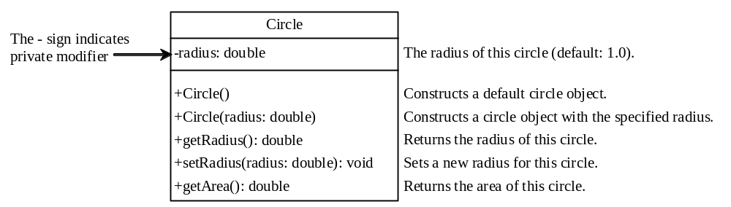
Example: New Circle Class
Circle2.h
Circle2.cpp

Slide 41
The Scope of Variables
Chapter 5, “Functions,” discussed the scope of global variables and local variables. Global variables are declared outside all functions and are accessible to all functions in its scope. The scope of a global variable starts from its declaration and continues to the end of the program. Local variables are defined inside functions. The scope of a local variable starts from its declaration and continues to the end of the block that contains the variable.

Slide 42
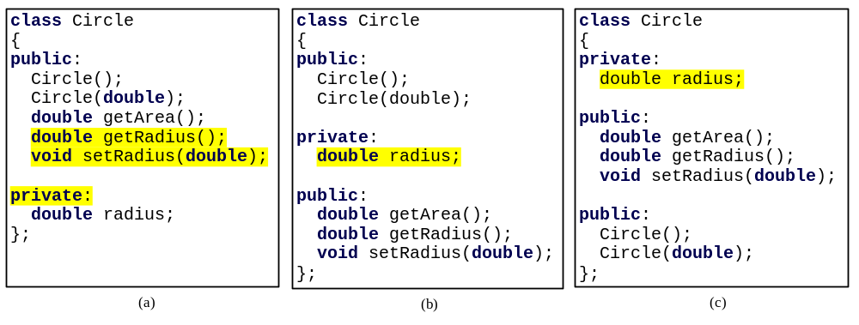
The Scope of Variables
The data fields are declared as variables and are accessible to all constructors and functions in the class. In this sense, data fields are like global variables. However, data fields and functions can be declared in any order in a class. For example, all the following declarations are the same:

Slide 43
The Scope of Variables
Local variables are declared and used inside a function locally. If a local variable has the same name as a data field, the local variable takes precedence and the data field with the same name is hidden. For example, in the following program in Listing 9.8, x is defined as a data field and as a local variable in the function.
HideDataField

Slide 44
The this Pointer
Sometimes you need to reference a class’s hidden data field in a function. For example, a property name is often used as the parameter name in a set function for the property. In this case, you need to reference the hidden property name in the function in order to set a new value to it. A hidden data field can be accessed by using the this keyword, which is a special built-in pointer that references to the calling object. You can rewrite the Circle class implementation in Listing 9.9 using the this pointer.
Circle3

Slide 45
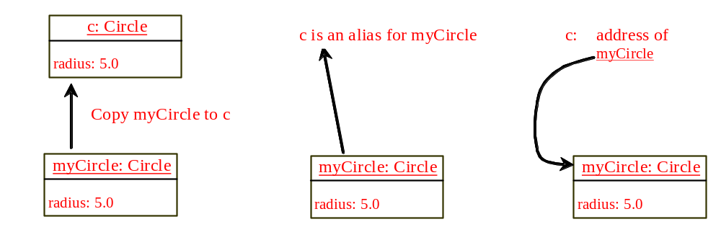
Passing Objects to Functions
You can pass objects by value or by reference.
PassObjectByValue
PassObjectByReference
PassObjectToPointer

Slide 46
Array of Objects
Circle circleArray[3] = {Circle(3), Circle(4), Circle(5)};
TotalArea

Slide 47

Class Abstraction and Encapsulation
Class abstraction means to separate class implementation from the use of the class. The creator of the class provides a description of the class and let the user know how the class can be used. The user of the class does not need to know how the class is implemented. The detail of implementation is encapsulated and hidden from the user.

Slide 48
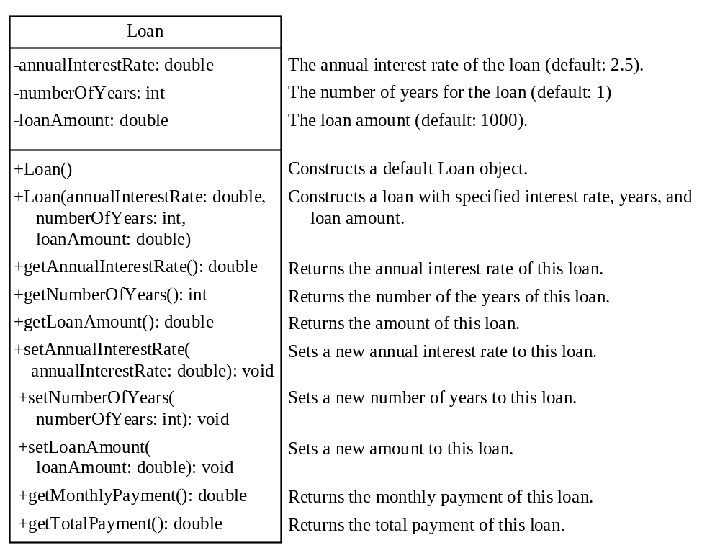
Example: The Loan Class
Loan.h
Loan.cpp
TestLoanClass

Slide 49
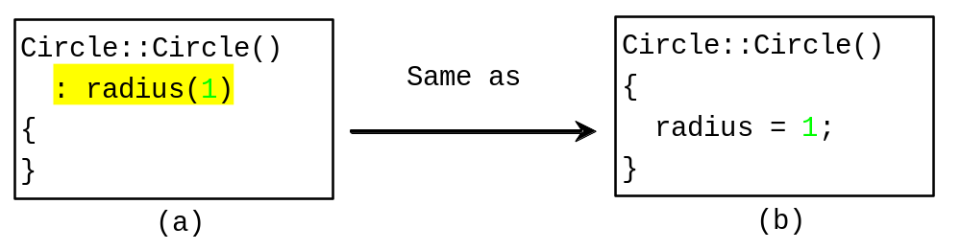
Constructor Initializer
Data fields may be initialized in the constructor using an initializer list in the following:
ClassName(parameterList)
:datafield1(value1),datafield2(value2)
{
}
Notes:
This form is required in inheritance.

Slide 50
Chapter Summary
You can separate class declaration from class implementation by defining class declaration in a header file and calls implementation in a separate file.
Visibility keywords specify how the class, function, and data are accessed. A public function or data is accessible to all clients. A private function or data is only accessible inside the class.
Notes:
Circumvent 规避

Slide 51
Chapter Summary
A class is a template for objects. It defines the generic properties of objects, and provides constructors for creating objects and functions for manipulating them.
A class is also a data type. You can use it to declare object names. An object is an instance of a class. You can use the dot operator to access members of that object through its name.
Notes:
Circumvent 规避

Slide 52
Chapter Summary
You can provide a get function or a set function to enable clients to see or modify the data.
The scope of data fields is the entire class, regardless of where the data fields are declared. The class members can declared anywhere in the class.
Notes:
Circumvent 规避

Slide 53
Chapter Summary
The keyword this can be used as a pointer to the calling object.
You can pass an object to a function by value, by reference, by reference via a pointer. For performance and simplicity, passing by reference is preferred.
Notes:
Circumvent 规避

